Slide 1



BUDGET AND INCOME TRACKER
PROJECT PROPOSAL
GUIDE BY---JEEJO (Senior Technical Trainer)
---ByteXl

Slide 2
MEET THE TEAM COOL AS CODE
99210041399 | MITHINTI ANUJA
99210041354 | MEESALA KAVYA SRI
99210041400 | MOPARTHI DHANALAKSHMI
99210041352 | MADDULA HEMANTH KUMAR
99210041591 | MOHAMMAD IRFAN
TEAM NAME—COOL AS CODE

Slide 3
TABLE OF CONTENTS
01
02
03
04
05
INTRODUCTION
Description of the project.
MAJOR REQUIREMENTS
Explanation of Modules and Classes used.
CLASSES INCLUDED
Structure of the project.
OUTPUTS
Screenshots of the project.
REFERENCES
References used for the project

Slide 4


INTRODUCTION
This project, the Expenses and Incomes Tracker, is a Java application designed to manage and track financial transactions. Built using Swing in NetBeans, it features a graphical interface where users can input dates, descriptions, amounts, and specify whether entries are expenses or incomes. The application dynamically updates a table with each entry, calculates and displays the current balance, and provides error handling for input validation. It's a practical tool for personal finance management, offering a straightforward way to monitor and analyze expenses and incomes in real-time.

Slide 5
OBJECTIVE
The objective is to develop a Java application for tracking expenses and incomes, facilitating easy input, display, and balance calculation of financial transactions.

Slide 6
MODULES USED IN THIS PROJECT
Java AbstractTableModel
Java Collections
Java Swing
Used for creating the graphical user interface (GUI).
Utilized for managing collections of ExpenseIncomeEntry objects in the ExpenseIncomeTableModel.
Extended to provide a custom table model (ExpenseIncomeTableModel) for displaying data in the JTable

Slide 7
MODULES USED IN THIS PROJECT
Java Exception Handling
FlatLaf
Java AWT
Used for basic layout management (BorderLayout, FlowLayout) in the ExpensesIncomesTracker class.
A third-party look and feel library for Swing that provides the modern flat appearance .
Used throughout the application to handle exceptions, particularly for parsing numeric values.

Slide 8
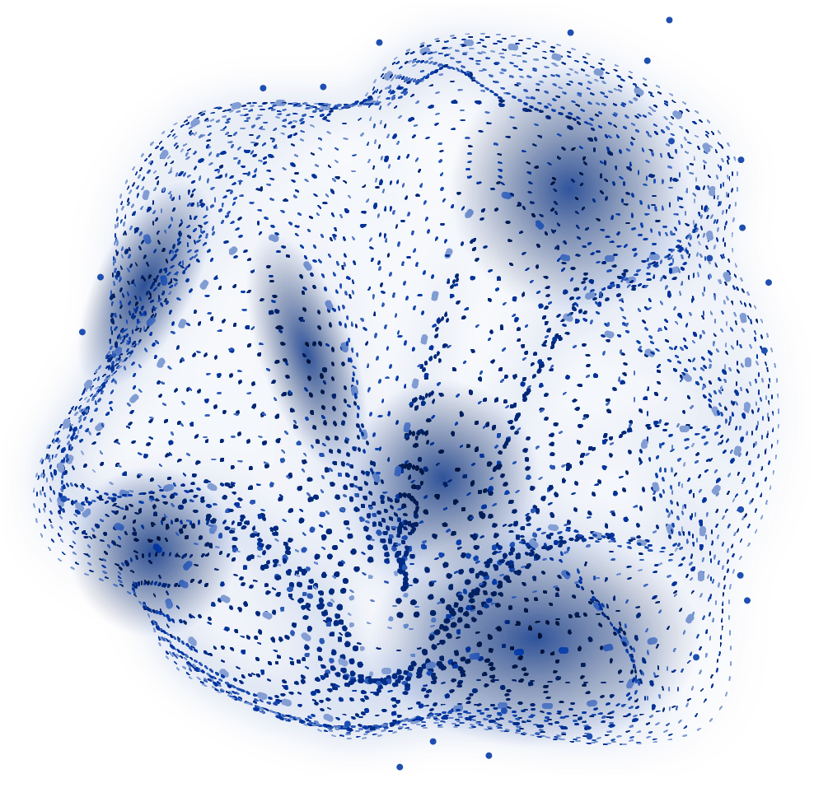
Classes used in the project

Slide 9
ExpenseIncomeEntry Class
Methods:
Constructor (ExpenseIncomeEntry(String date, String description, double amount, String type): Initializes the fields of the entry.
Getters
(getDate(), getDescription(), getAmount(), getType()): Provides access to the fields of the entry.
Fields:
date: Stores the date of the entry.
Description: Stores a description of the entry.
Amount: Stores the amount (positive for income, negative for expense).
Type: Indicates whether the entry is an expense or income.

Slide 10
ExpenseIncomeTableModel Class
Fields:
Entries: List of ExpenseIncomeEntry objects containing all entries.
ColumnNames: Array of column names for the table ({"Date", "Description", "Amount", "Type"}).
Methods:
addEntry(ExpenseIncomeEntry
entry):
Adds a new entry to the entries list and notifies the table of the new row.
getRowCount(), getColumnCount(), getColumnName(intcolumn), getValueAt(int rowIndex, int columnIndex): Methods required by AbstractTableModel to define the structure and data of the table.

Slide 11
ExpensesIncomesTracker Class
Fields:
Tablemodel: Instance of ExpenseIncomeTableModel for managing table data.
Table: JTable displaying expense and income entries.
dateField,descriptionField, amountField, typeCombobox: JTextField, JComboBox, and JButton for adding new entries.
Balancelabel: JLabel to display the current balance.
Balance: Stores the current balance.
Methods:
Constructor (ExpensesIncomesTracker()): Initializes UI components, sets look and feel (FlatDarkLaf), and configures layout.
Addentry(): Handles adding new entries to the table, validates input, updates balance, and updates UI components accordingly.
Clearinputfields(): Clears input fields (dateField, descriptionField, amountField, typeCombobox) after adding an entry.

Slide 12
FLOW OF PROJECT
Enter the Monthly Income.
Table Update and Balance Calculations.
Step2
Step4
STEP1
Step3
Display User Interface.
Enter Monthly Expenses.

Slide 13
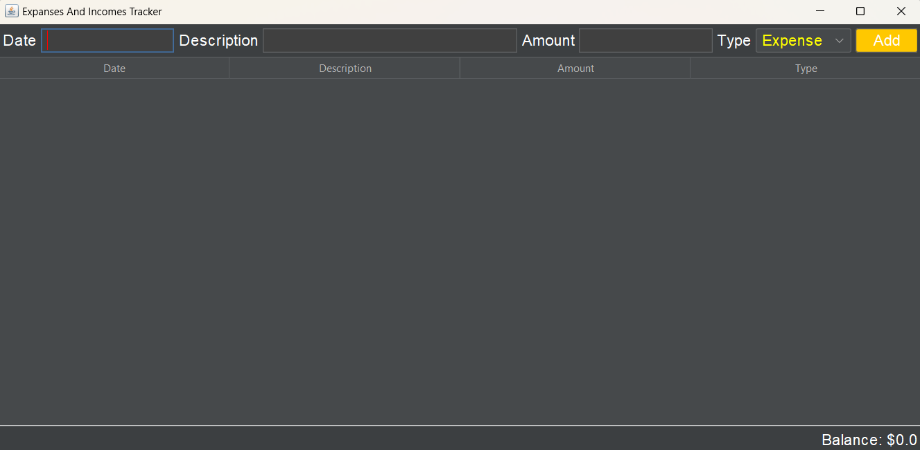
OUTPUTS 1.Dispayed User Interface

Slide 14
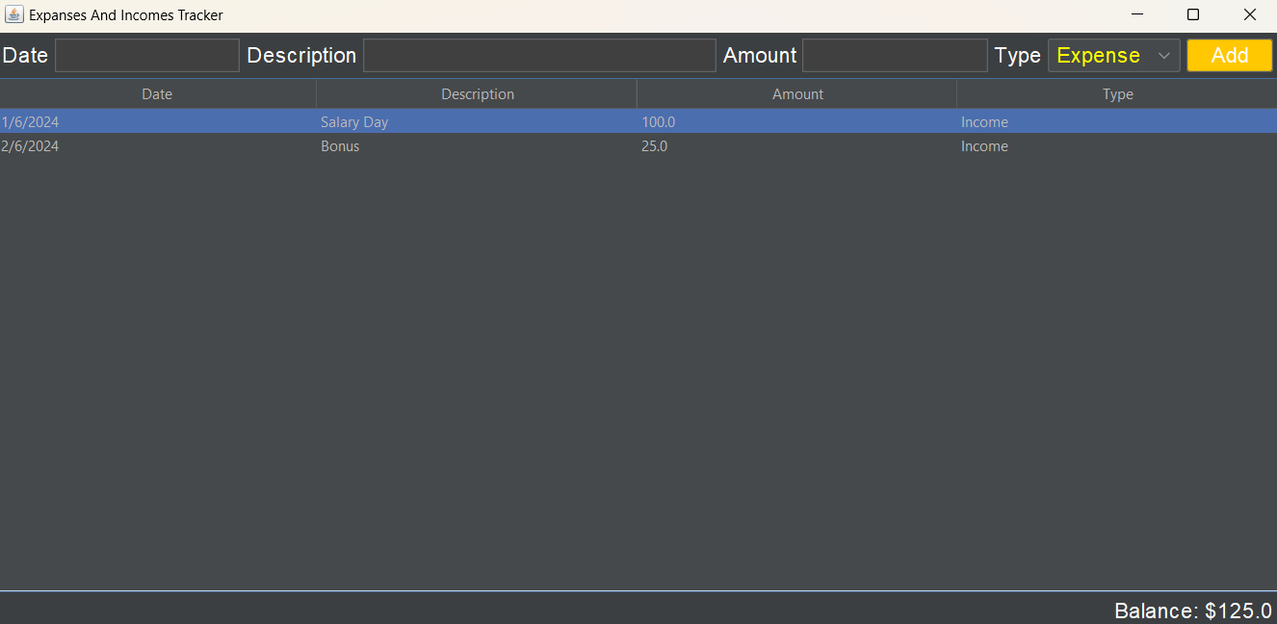
Entering Monthly Incomes

Slide 15
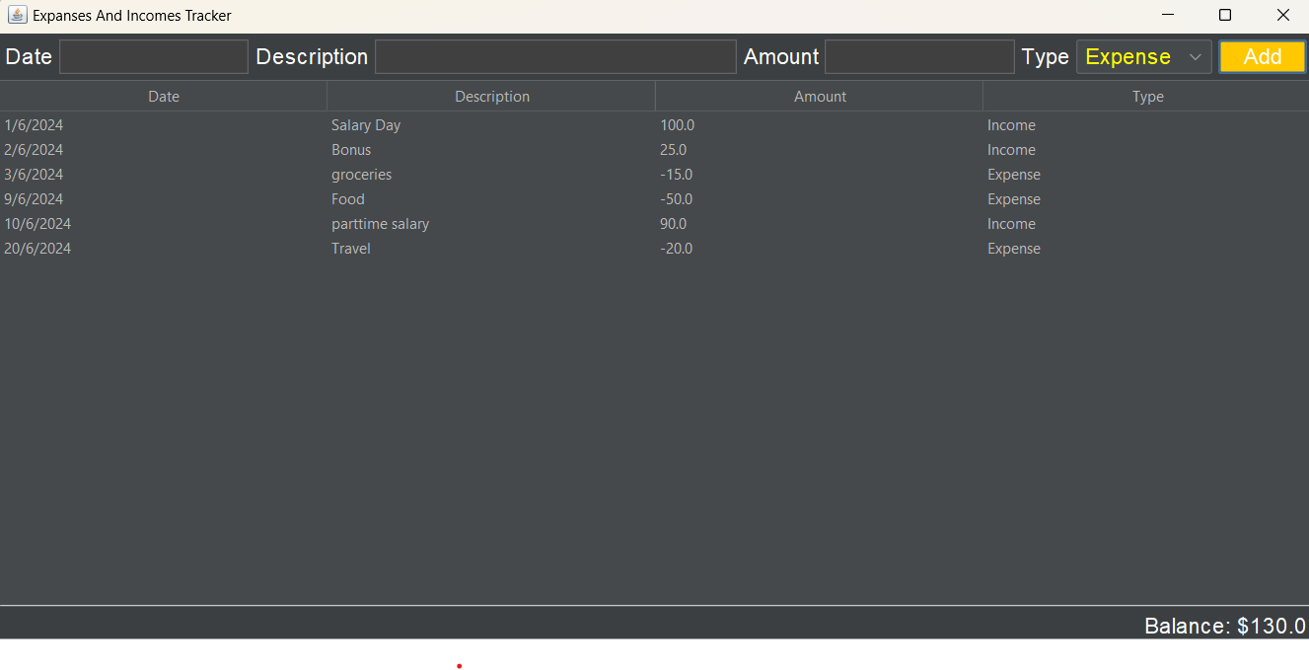
Entering Monthly Expenses and updating Balance

Slide 16
REFERENCES
GITHUB
AI TOOLS
REPOSITORIES
CHATGPT
YOUTUBE
JOURNALS
JAVA TUTORIALS
SOME RESEARCH PAPPERS

Slide 17
THANK YOU

